Slide 1


Slide 2


Financial Data Science BootCamp
Why did you join this session today? What information are you looking for?
What skills/career based goals do you have for the next 6 months?

Slide 3
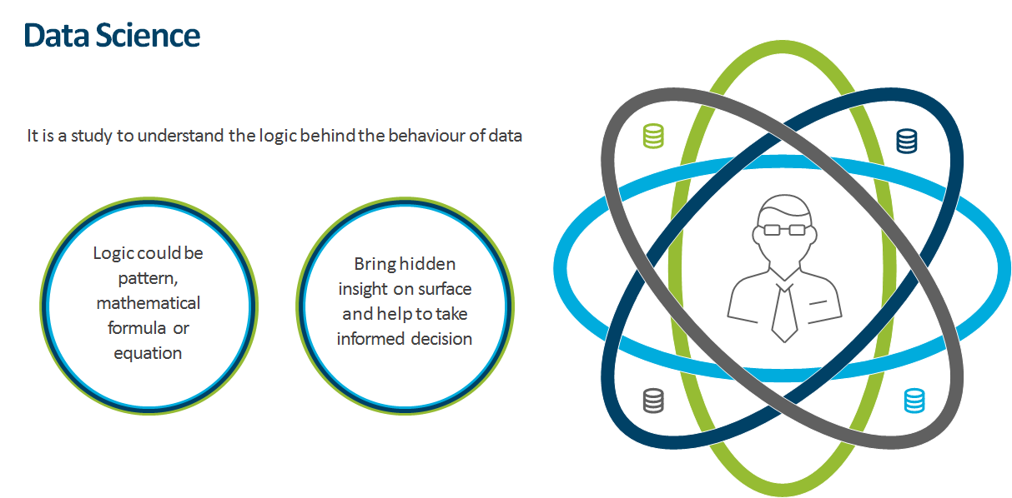
What is Financial Data Science?
Study of data
Involves methods of recording, storing and analyzing data to extract information
The ultimate goal is to extract insights and knowledge from the analysis upon which other will take action!

Slide 4
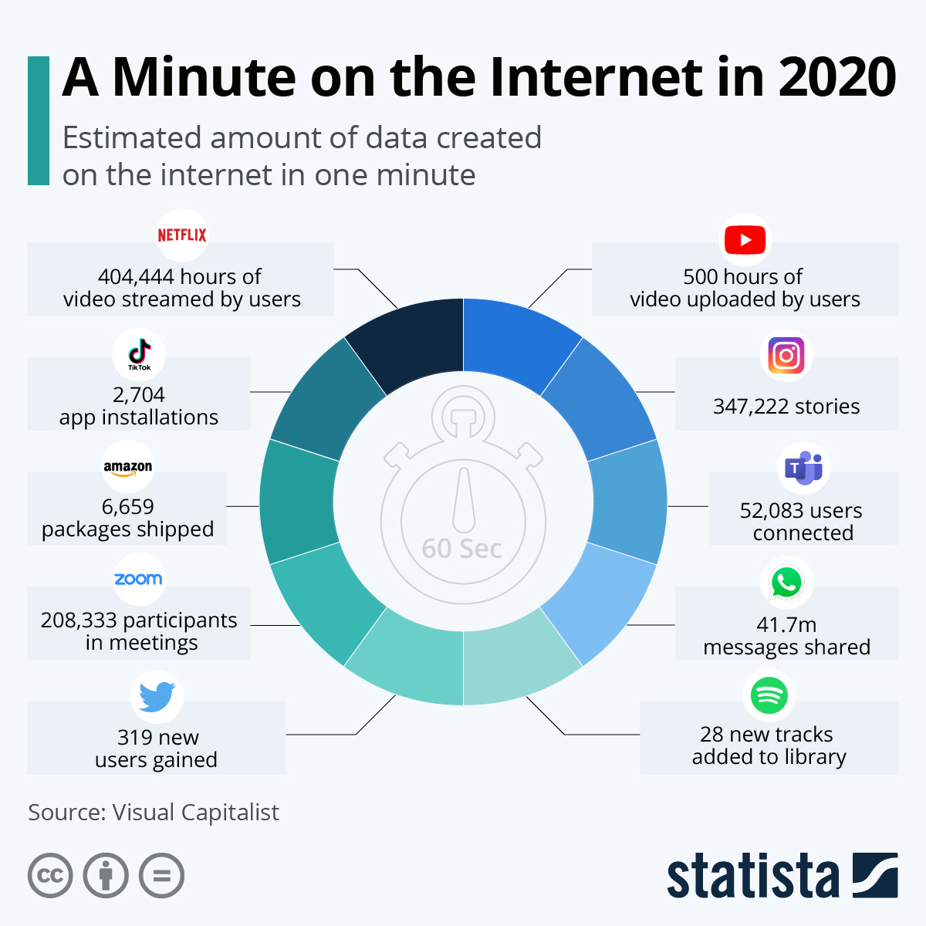
Why Financial Data Science?
Data roles have been billed at the hottest roles of the 21st century!
According to a report by BHEF and PWC, 70% of business leaders in the United States will prefer job applicants with data skills by 2021.
According to Glassdoor's 50 Best Jobs in America for 2020, data scientist remains in the top three best positions in the U.S., with a high job satisfaction and median base salary over $80-100k.
Source: Statista
Notes:
As of 2020, 59% of world’s population is online!
Data is the new oil! It is an essential resource that powers the information economy in much the way that oil has fueled the industrial economy.

Slide 5
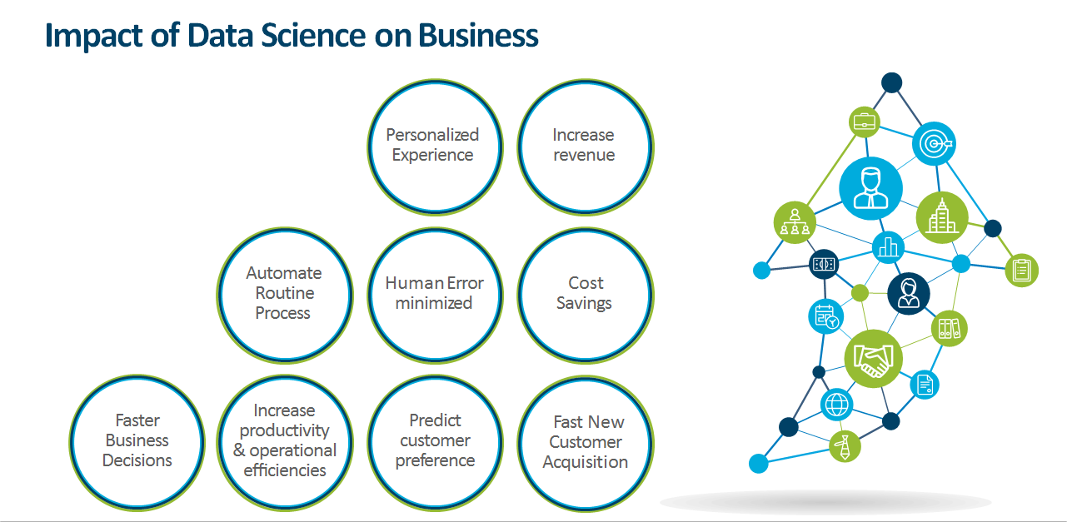
Impact of Data Science & Analytics on Business
Notes:
Data is really involved in all aspects of the business.
-Something like personalized experience for e.g. When you are looking at Netflix, what are the recommendations that you get,
-Increasing revenue, making sure that we are providing the information of the pieces that customers want to purchase,
-Cost savings, minimizing human error, faster customer acquisition, predicting customer preference - you know in all of these places DA and DS really allow us to hone and refine our process.
So any business process can be served and utilized by the folks in the DA and DS teams,
I always say that numbers are the best storytellers as we often have a perception of how our business is doing or a perception of what our customers want, but when we dig into their actual behaviour, we may sometimes find out that those results are somewhat counter intuitive

Slide 6
Data Career Opportunities
DATA ANALYST Retrieves, gathers, organizes, and utilizes data to reach meaningful conclusions. | STATISTICIAN Performs statistical tests on sample data sets and helps a data scientist decide on whether to proceed with a problem statement or not. | DATA SCIENTIST Works on improving business efficiencies and creates new product features using large scale data predictions and forecasts.
DATA ENGINEER Prepares the data infrastructure to be analyzed by data scientists and analysts. Designs, builds, and integrates data from various resources, and manages big data. | DATA ARCHITECT Sets up a scalable workﬂow process pipeline, such as data source, to a data process engine. | BI EXPERT Displays key results in the form of charts and dashboards to clients or management.
Notes:
Talk about How DS and DA are the focus exit roles of the bootcamps, however there are a lot of overlaps (Ex: data wrangling and EDA is done by DS too), depending on size and nature of company etc. The skills covered in the bootcamp ensures the student is ready for a wide variety of roles.

Slide 7
Skill Sets for Data Science & Analytics
Data Science Computer Science Machine Learning Software Development Big Data Engineering Algorithm Development | Data Science & Analytics Statistical Analysis Problem Solving Data Storytelling Analytical Eye and Attention to Detail Business Acumen Communication Skills Data Mining | Data Analytics Data Analysis Software Database Management Systems Business Intelligence Tools Data Visualization Tools

Slide 8






Typical Interview Process for Data Jobs
The UNF Data Bootcamps prepare you for each stage of the interview process
1
2
3
4
5
HR Screen
Technical Screen
Onsite (Virtual/In-person)
Negotiation & Offer
Optional Coding Challenge (companies are slowly moving away from this)
Take Home Assignment

Slide 9
Data Life Cycle – Day in the Life
Problem Definition
Insight
Capture
Data Cycle
Analyze
Process

Slide 10
Data Science & Analytics Industries
Industry Verticals
Application Horizontals
All Industries!
Industry sectors with highest requirements
Banking/Finance - 38%
Energy - 13%
Pharma & Healthcare -12%
E-commerce - 11%
Media - 7%
Retail - 6%
Others - 13%
Pricing
Marketing analysis
Recommendation systems
Operations and securities
Customer Analysis
Customer support
Source: Tech target

Slide 11
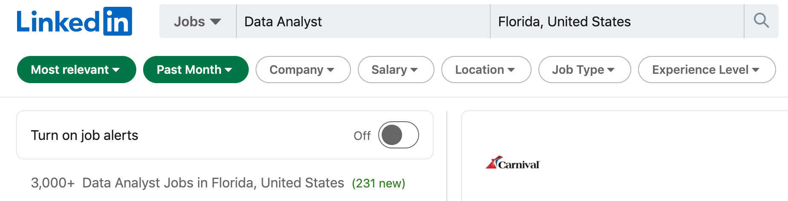
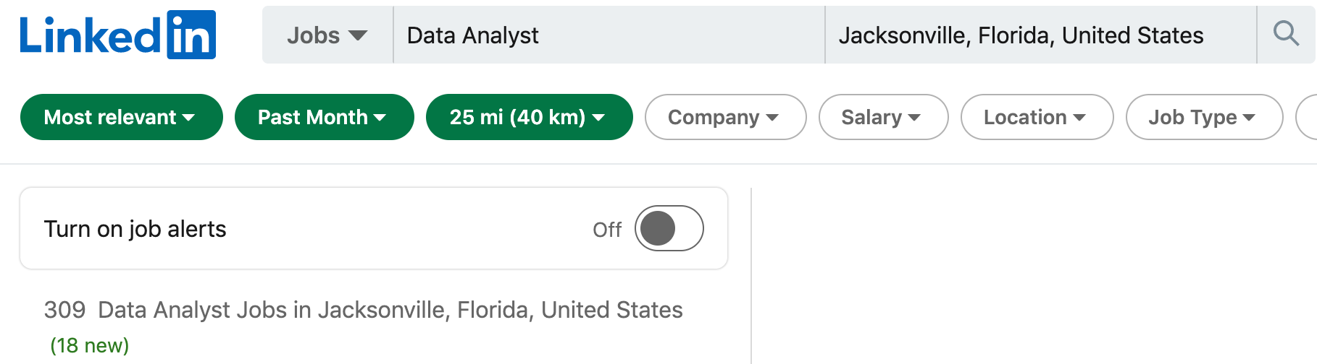
Data Analyst Roles in Jacksonville
Check it out!
There are lots of roles in Analytics in the Jacksonville area! Some recent listings include
Data Analyst – Fidelity Investments
Senior Financial Analyst - Amazon
Data Analyst – Deutsche Bank
Business Analyst – JPMorgan Chase
Ops Business Metrics Analyst - Citi
Business Operations Analyst -VMware
Business Systems Analyst – Kemper
Health Business Analyst – Florida Blue
Sr. Analyst, BI & Analytics - JLL
Business Systems Analyst - Brooksource
Notes:
3000+ DA jobs were posted in the Florida region in just the last month, with 309 being in the Jacksonville area. A wide variety of job openings have been posted by big brands like Amazon and Deutsche bank as well as by startups

Slide 12
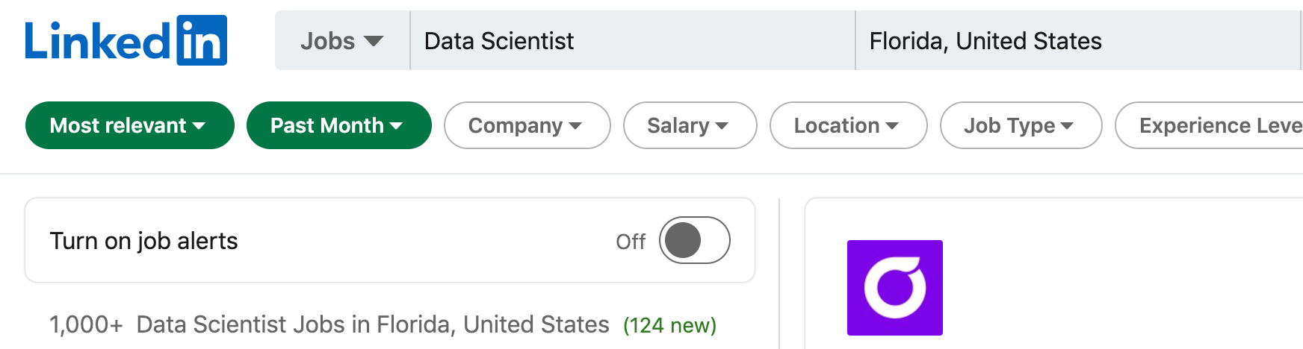
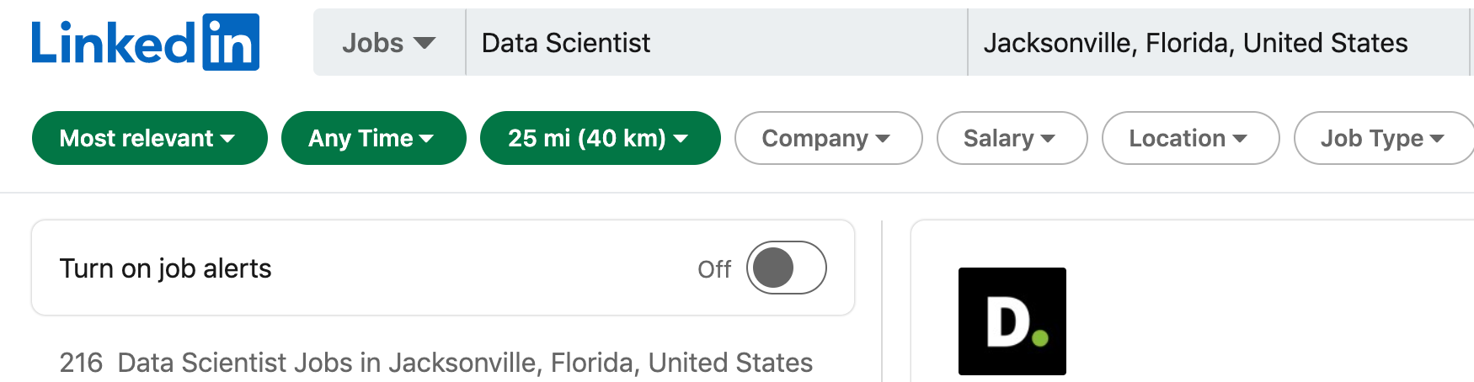
Data Science Roles in Jacksonville
Check it out!
There are lots of roles in Data Science in the Jacksonville area as well!
Some recent listings include
Data Scientist – Amazon Web Services
Data Scientist – Deloitte
VP, Data Scientist List - JP Morgan
Data Modeler – Kemper
Data Scientist II – Crowley
Data Science Analyst – SourceAbled
Senior Informatics – CVS
Federal Data Scientist – US Government
Senior Data Scientist - FIS
Notes:
1800+ DS jobs were posted in the Florida region in just the last month, with 216 being in the Jacksonville area. A wide variety of job openings have been posted by big brands like Amazon, Deloitte, JP Morgan as well as by startups

Slide 13
Who can pursue a Data Bootcamp?
Good news! Professionals from any industry or background can change their career path to data roles.
A career in data might be right for you if...
You like to analyze things (understanding how, why, what)
You love to communicate and present your findings in a simple and meaningful way
You enjoy working in cross-functional teams
You want to make an impact in decision making at your organization
You are willing to learn continuously!
Did you know?
UNF’s Data Science Bootcamp requires a working knowledge of Python and statistics to succeed in the course.
We also offer a data science foundations course, if you would like to build these skills!
Notes:
Both Data Analytics and data science requires a professional to have business knowledge. This makes it easy for professionals from different industries/backgrounds to transition to a career in the Data space

Slide 14

Why enroll in the UNF Data Bootcamp?
Experience a curriculum curated by subject matter experts and hiring managers
Study on your schedule, 100% online
Receive 1-on-1 mentorship, student advising, and career coaching throughout the bootcamp
Graduate with a portfolio of work and a certificate of completion from UNF Division of Continuing Education
Earn UNF alumni status on graduation

Slide 15

Project-Based Curriculum
~500 hours of industry-driven curriculum
~50 hours of career content
Regularly updated to align with industry demands
20+ mini projects
2 portfolio worthy capstone projects
Exercises with every unit

Slide 16

1:1 Mentorship
Students receive:
1-on-1 weekly mentor calls with industry experts
Unlimited mentor calls for additional guidance
A mentor will:
Help you apply theoretical concepts to tackle real-world problems
Guide you through the curriculum, provide project guidance and feedback, and share industry insights

Slide 17

1:1 Career Coaching
Career-focused course material is paired with personal coaching calls to help you land your dream job!
Receive unlimited access to calls with your career coach, and full career support for 6 months after completing the program.
With your Career Coach, you will:
Create a successful job search strategy, learn effective networking skills, and identify target job titles and companies
Craft an effective data resume and LinkedIn profile
Learn to ace job interviews and negotiate your salary

Slide 18

Support & Community
Student Support Resources:
An assigned advisor for progress check-ins, online learning tips, and more
A dedicated course TA to provide technical assistance
Student Community:
Receive access to a Slack channel where you can share ideas, ask questions, get feedback, and see the types of projects your peers are working on

Slide 19
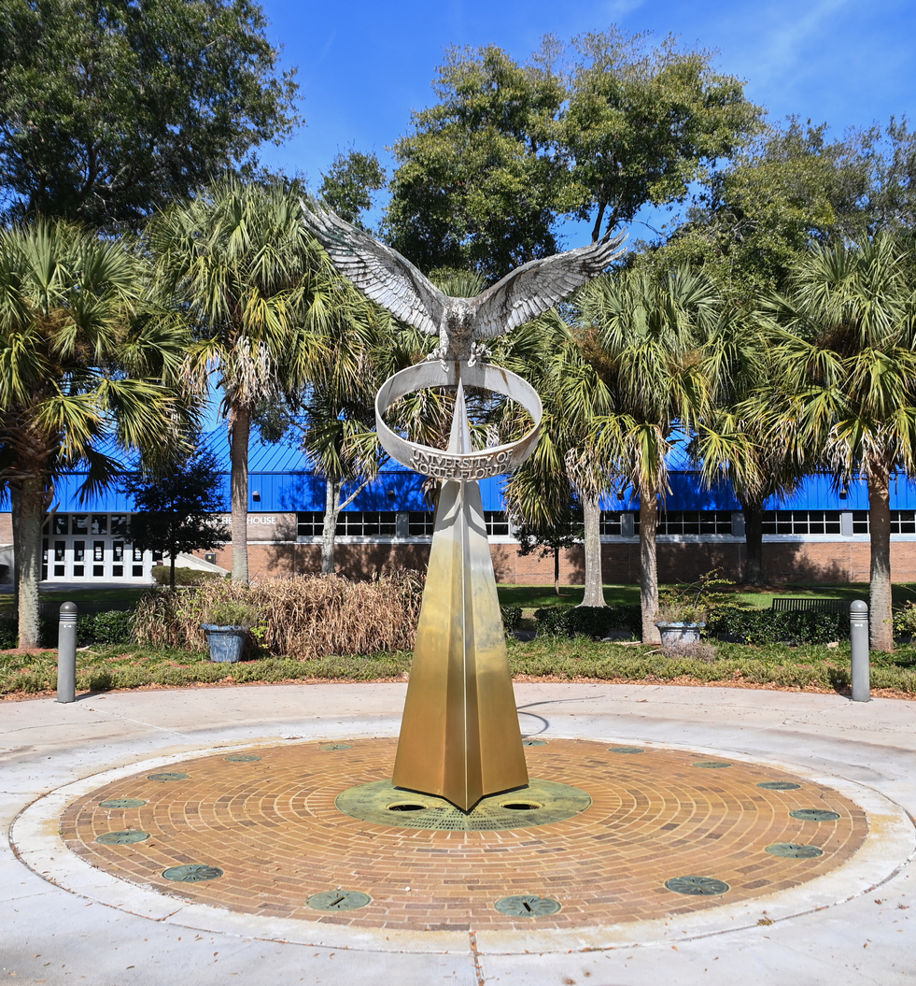
Admissions
Eligibility:
All backgrounds are welcome; no prior data/coding experience is needed.
Admissions Process:
Complete a phone call with an Admissions Director (if you haven’t yet) at (904) 274-5196. This call will be used to further explore your career goals and learning needs, and address any further questions
Take the Technical Skills Survey (TSS), which will evaluate your familiarity with the technical skills required for the course
Use code “UNFSESSION” for a $750 scholarship.
Important Dates:
New cohorts begin on the first Monday of every month
The priority deadline for enrollment is two weeks prior to a new cohort start date
Notes:
Enroll before 21st June to avail the $750 scholarship
Please note that this scholarship code is not stackable over the women in tech and veterans in tech scholarships

Slide 20

Q&A

Slide 21
Thank you for attending!
Admissions deadline: July 26, 2021
Next cohort starts on: Aug 2, 2021
Contact us: (904) 274-5196
unf@career-bootcamp.com

